Slide 1
HRS at small angles for e+/ e- pair for APEX
Paul Brindza, Jefferson Lab
Septum magnets and radiation
APEX
schematic

Slide 2
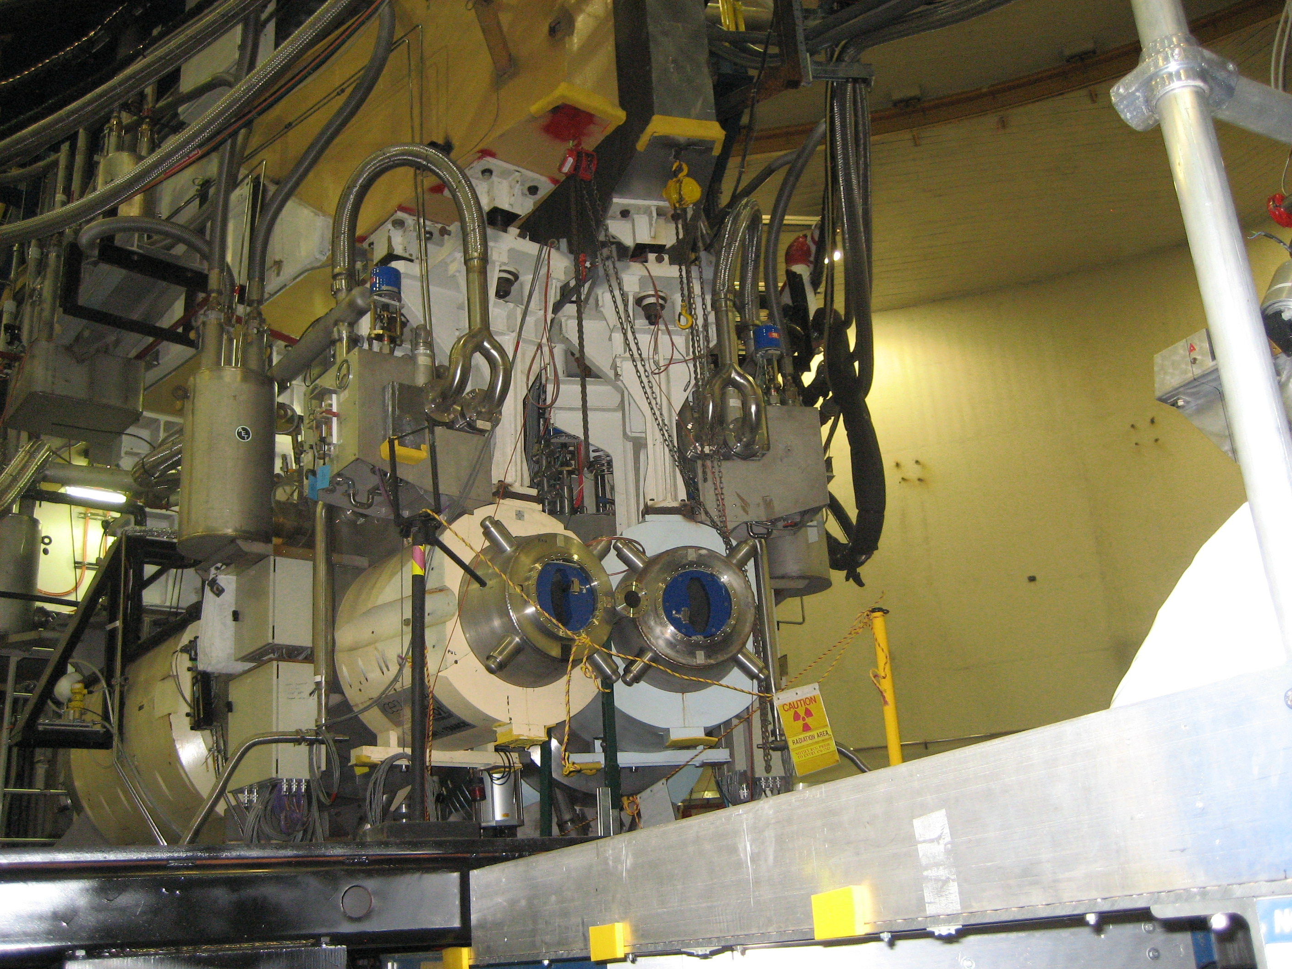
HRS view for PREX

Slide 3
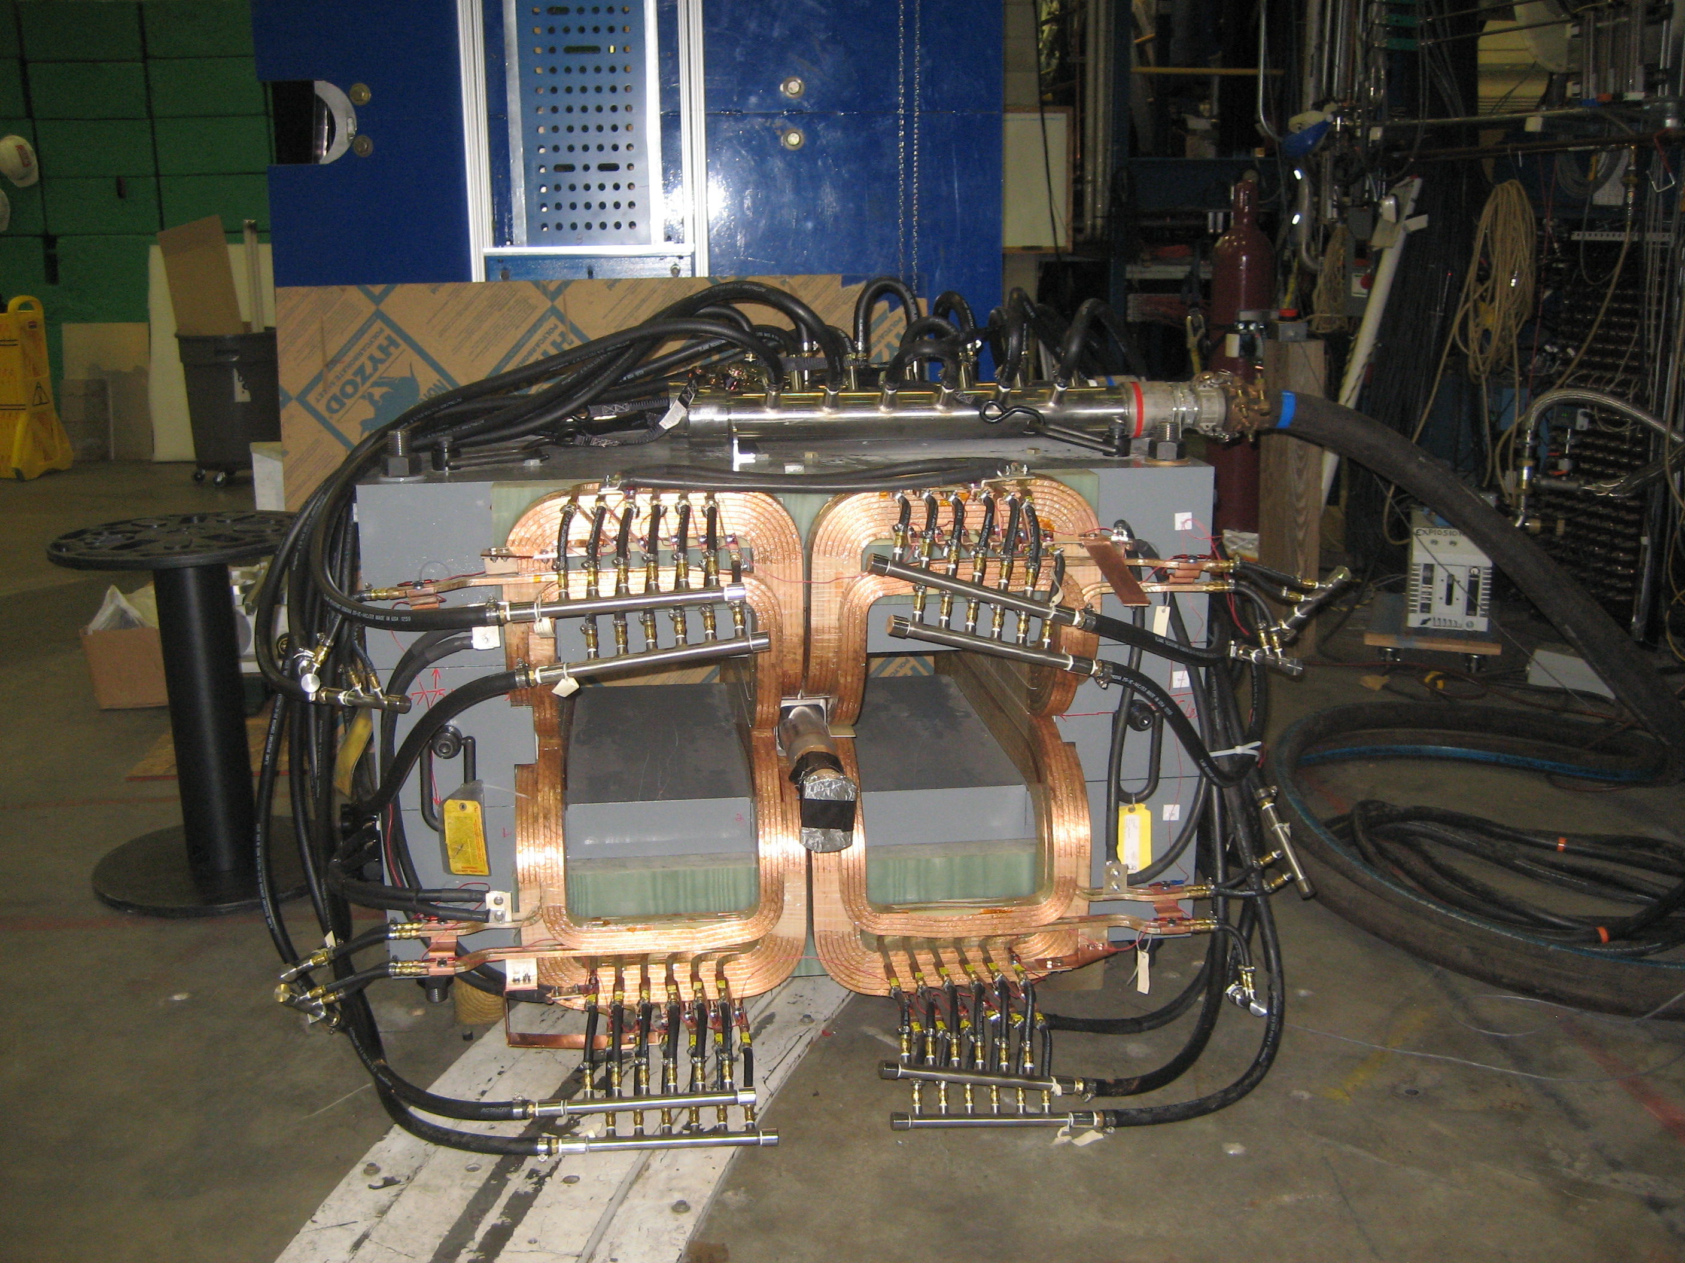
Hall A RT Septum magnet

Slide 4
View downstream from the target
Showing sieve slit

Slide 5
RT Septum as installed for PREX

Slide 6
Beam Line field shield for PREX

Slide 7
PREX septa magnets 2010
Magnetic field on beam line for e+e- configuration APEX Test Run
Custom beam line for APEX June 2010

Slide 8
RT Septum Modifications for APEX
RT Septum in High field configuration ie. all three coil sets installed and parallel fields
Improved beam line field shield for parallel field operation
Use soft iron shield that is 2 cm thick on mid plane
Field shield extends +/- 100 cm from RT septum center
Preserve beam aperture 7.0 cm diameter

Slide 9
RT septum model with coils spaced +/- 2 cm

Slide 10
Model side view showing extended field shield

Slide 11
Original PREX shield

Slide 12
RT Septum with original length 1 cm thick shield

Slide 13
Field on beam line for 2 cm thick long shield

Slide 14
Saturation in the 2 cm shield at center

Slide 15
Saturation in shield at yoke end and coil end
Edge of yoke
End of coils

Slide 16
Field in iron shield mid plane along “Z”

Slide 17
Field details along beam line

Slide 18
Integral BdL along gap center

Slide 19
RT Septum across gap in magnet mid plane

Slide 20
Cost and time impact of septum beam shield
Iron shield needs to be 2 cm thick in mid plane and ~ 200 cm long. Current shield is length of yoke.
RT septum will need coil spacers to fit the new coil spacing of +/- 1 cm.
RT septum must be disassembled to install new beam shield and change coil spacing.
Cost is about $20,000 plus at least two weeks for several Hall A techs.

Slide 21
APEX Beam Shield Cost
Iron 350 # annealed $ 3500
Boring 80 hr at 50$/hr $ 4000
Bellows and flanges $ 4000
Welding & leak checking $ 2000
Use $20,000 for new shield components plus Hall A labor

Slide 22
Latest radiation budget

Slide 23
Conclusions
RT Septum meets requirements for APEX
APEX requires use of all three coils sets (same as G2P) in parallel field mode
RT Septum requires 2 DC supplies for high field 240 V 1100 A each
Requires a thicker and longer beam field shield
Modifications have reasonable cost and time impact

